Slide 1



揭秘IEEE：高效文献调研与学术论文发表
周瑜玲
IEEE产品培训师
iGroup 2020
欢迎关注“IEEE Xplore 微服务”

Slide 2



Contents
01 /
IEEE资源介绍
02 /
高效文献调研与热点追踪
03 /
IEEE出版渠道选择及投稿注意事项
04 /
IEEE活动介绍，助力科研与职业发展

Slide 3
IEEE简介

Slide 4

the Institute of Electrical and Electronics Engineers
电气电子工程师学会
IEEE, pronounced "Eye-triple-E"

Slide 5
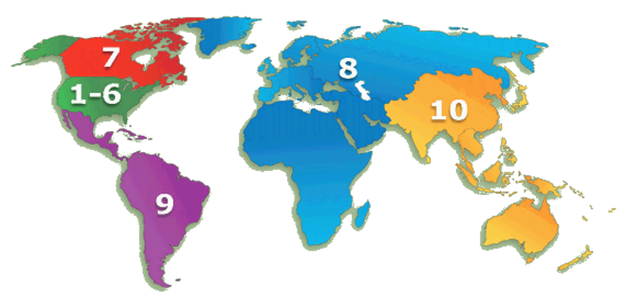
IEEE组织情况
非营利组织，全球最大的技术行业学会，成员遍布180多个国家地区，会员超过43万人
300多个地方分会
2000多个专业委员会
100多个国家的3000多个学生分会

Slide 6
IEEE Aerospace and Electronic Systems Society
IEEE Antennas and Propagation Society
IEEE Broadcast Technology Society
IEEE Circuits and Systems Society
IEEE Communications Society
IEEE Computational Intelligence Society
IEEE Computer Society
IEEE Consumer Electronics Society
IEEE Control Systems Society
IEEE Dielectrics and Electrical Insulation Society
IEEE Education Society
IEEE Electron Devices Society
IEEE Electronics Packaging Society
IEEE Electromagnetic Compatibility Society
IEEE Engineering in Medicine and Biology Society
IEEE Geoscience and Remote Sensing Society
IEEE Industrial Electronics Society
IEEE Industry Applications Society
IEEE Information Theory Society
IEEE Instrumentation and Measurement Society
IEEE Intelligent Transportation Systems Society
IEEE Magnetics Society
IEEE Microwave Theory and Techniques Society
IEEE Nuclear and Plasma Sciences Society
IEEE Oceanic Engineering Society
IEEE Photonics Society
IEEE Power Electronics Society
IEEE Power & Energy Society
IEEE Product Safety Engineering Society
IEEE Professional Communication Society
IEEE Reliability Society
IEEE Robotics and Automation Society
IEEE Signal Processing Society
IEEE Society on Social Implications of Technology
IEEE Solid-State Circuits Society
IEEE Systems, Man, and Cybernetics Society
IEEE Technology and Engineering Management Society
IEEE Ultrasonics, Ferroelectrics, and Frequency Control Society
IEEE Vehicular Technology Society
39个专业协会
IEEE Societies
Notes:
IEEE Components, Packaging, and Manufacturing Technology Society
（IEEE CPMT Society） has changed its name to the IEEE Electronics Packaging Society.

Slide 7

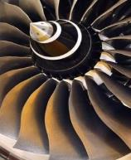
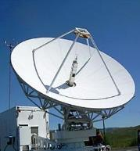


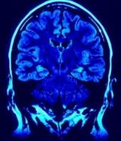

IEEE涵盖各个科技领域
More than just electrical engineering & computer science
• Information Technology
• Medical Devices
• Nanotechnology
• Optics
• Petroleum & Gas
• Power Electronics
• Power Systems
• Robotics & Automation
• Semiconductors
• Smart Grid
• Wireless Broadband
and more
• Aerospace & Defense
• Automotive Engineering
• Biomedical Engineering
• Biometrics
• Circuits & Systems
• Cloud Computing
• Communications
• Computer Software
• Electronics
• Energy
• Engineering
• Imaging
出版世界电气电子工程和计算机领域
的文献

Slide 8

校内IP控制
URL: https://ieeexplore.ieee.org

Slide 9
IEEE Xplore 全文数据库
190+ IEEE期刊和杂志
1800+ IEEE会议录（每年）
8000+ IEEE标准文档
IET、VDE会议录
Bell Labs技术期刊
IBM期刊，MIT期刊, AGU期刊, URSI
(OA 期刊): TUP, CSEE, CPSS, CES, CMP，BIAI，SAIEE
IEEE-Wiley, Wiley Telecom，MIT、Artech House、River电子书
Morgan & Claypool，Now Publishers综述文集
SMPTE期刊、会议、标准
在线技术课程
190+ IEEE期刊和杂志
1800+ IEEE会议录（每年）
4400+ IEEE标准文档（草案除外）
IET、VDE会议录
Bell Labs技术期刊
IEEE Electronic Library (IEL) 数据库
推荐使用谷歌或火狐浏览器
Notes:
IET:英国工程技术学会
VDE：德国电气工程师学会
AGU：美国地球物理学会
TUP：清华大学学报英文版
CSEE 中国电机工程学会
BIAI：北京航天情报与信息研究所 期刊
New OA Journals:
China Power Supply Society (CPSS)中国电源学会
Transactions on Power Electronics and Applications
China Electrotechnical Society (CES)中国电工技术学会
Transactions on Electrical Machines and Systems (CES-TEMS)
China Machine Press (CMP)机械工业出版社
Chinese Journal of Electrical Engineering (CJEE
URSI Radio Science Bulletin<法>国际无线电科学联合会
IEEE-Wiley：IEEE和Wiley合作出版的电子书近800本，横跨众多技术领域，包括生物工程、电力能源、通信技术等多方面研究
MIT：计算机科学和工程技术方面电子书600多本
Morgan & Claypool：综述文集700多本，重点聚焦工程和计算机科学
SMPTE 美国电影电视工程师学会 期刊、会议、标准

Slide 10
高效文献调研与热点追踪

Slide 11

一框式检索核心技术
一框式检索(Global Search)
1. 默认检索内容：metadata only
2. 检索词之间的默认关系：AND ie. smart grid= smart AND grid
3. 支持命令检索： ie. "Abstract":ofdm AND "Publication Title":communications
4. 自动获取词根：pluralized nouns, verb tenses, and British/American spelling variations
5. 精确检索使用双引号：词组、固定搭配 ie. “java programming”
6. 模糊检索使用*和？
7. 检索词不区分大小写，检索运算全部大写

Slide 12
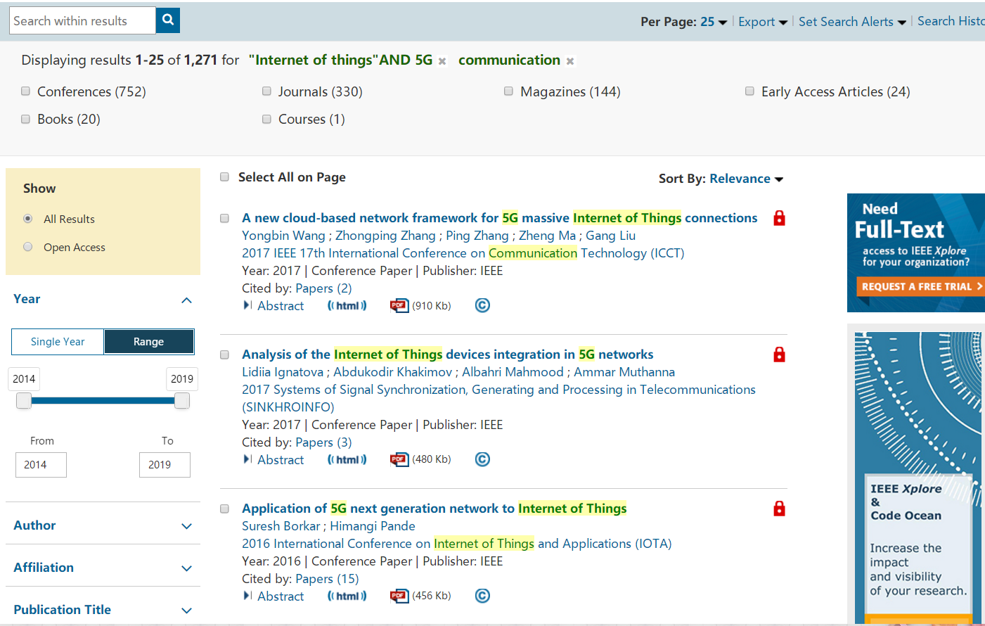
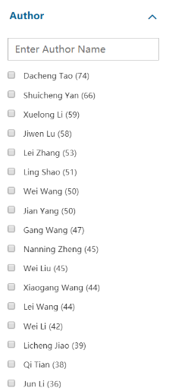
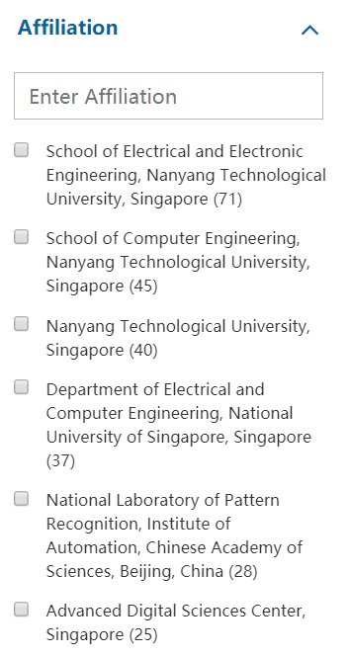
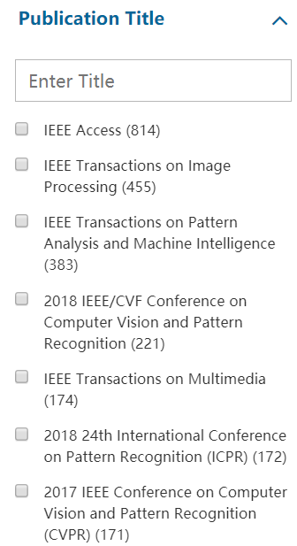
聚类分析：了解技术整体研发状况

Slide 13
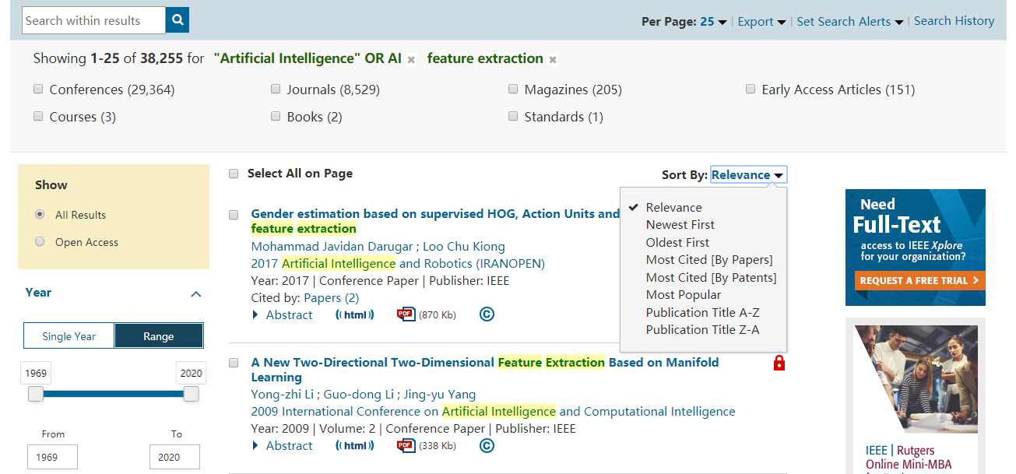
结果排序：寻找权威文章
高被引文献

Slide 14

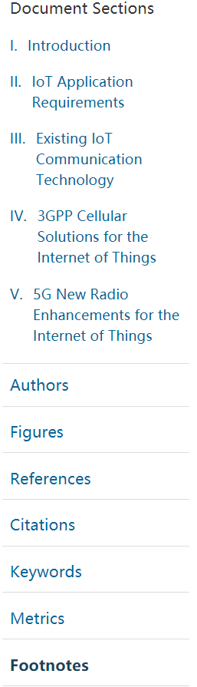
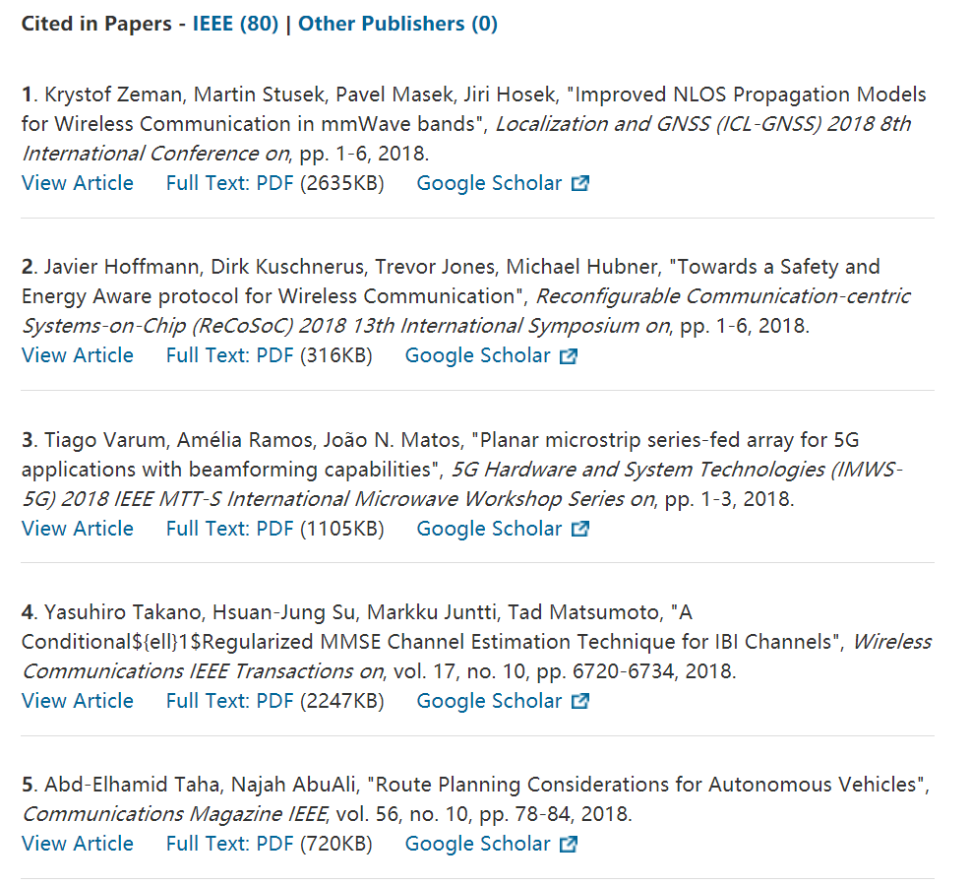
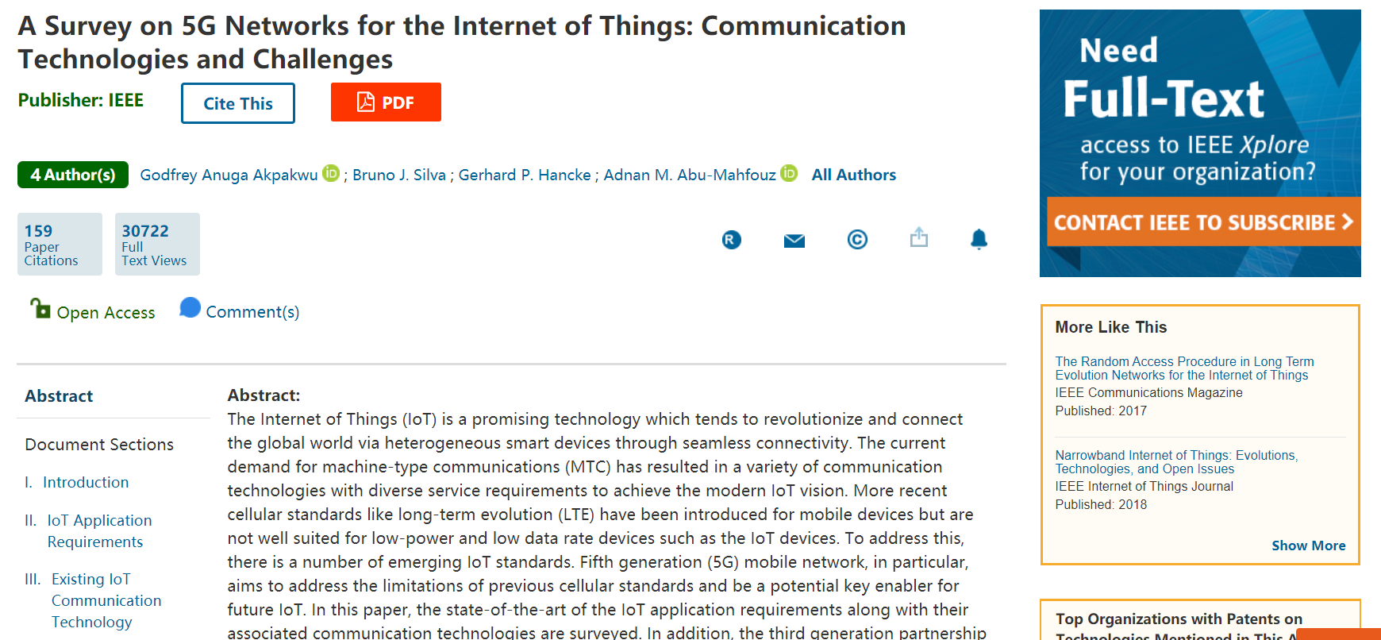
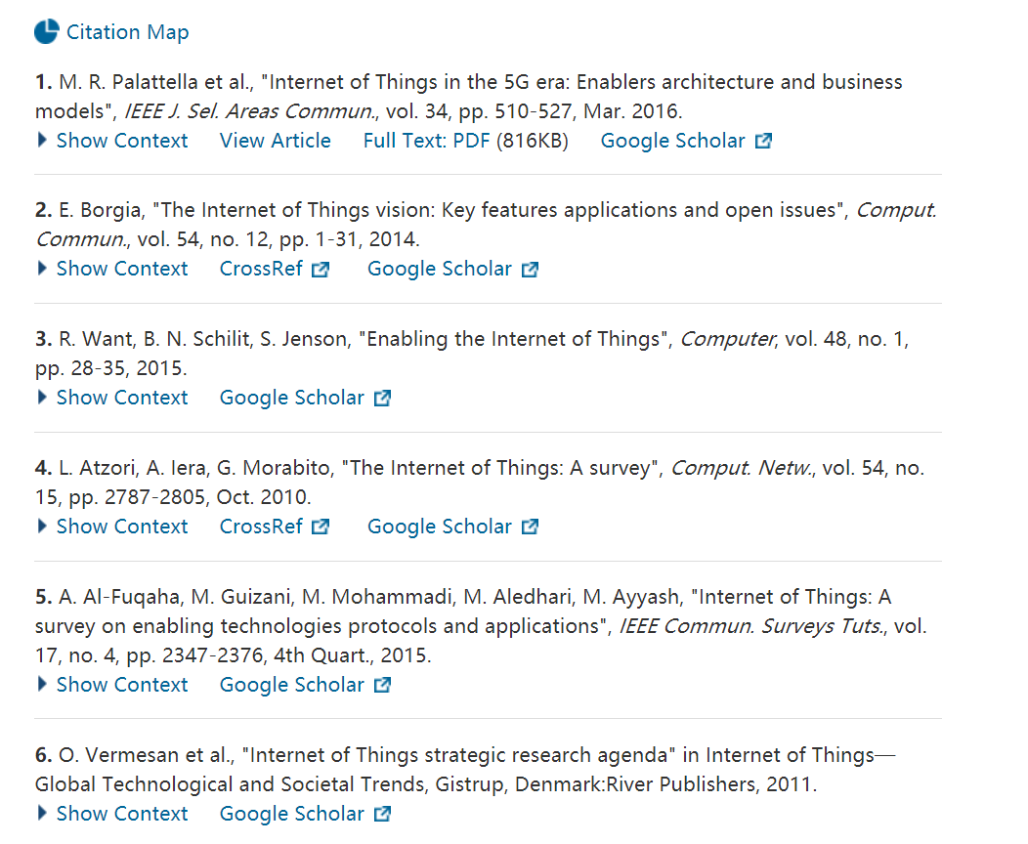
文章细节页面
不可使用批量下载软件下载
参考文献：更快获取参考文献全文，追溯经典文献
施引文献：快速获取引文全文，了解领域研究进展
了解作者详情

Slide 15
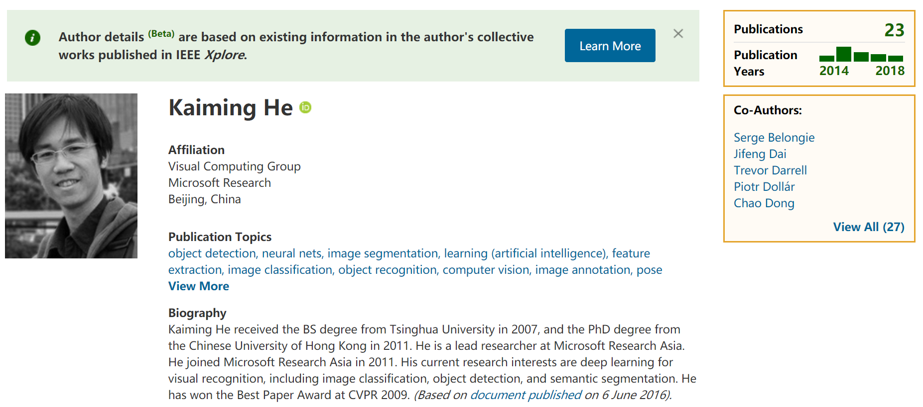
作者档案
iD: ORCID=Open Researcher and Contributor ID
开放研究者及贡献者唯一标识符
作用：
    a. 链接其他平台的发文，建立paper file
    b. ID数字用于区分同名同姓作者
    c. 在IEEE发文

Slide 16
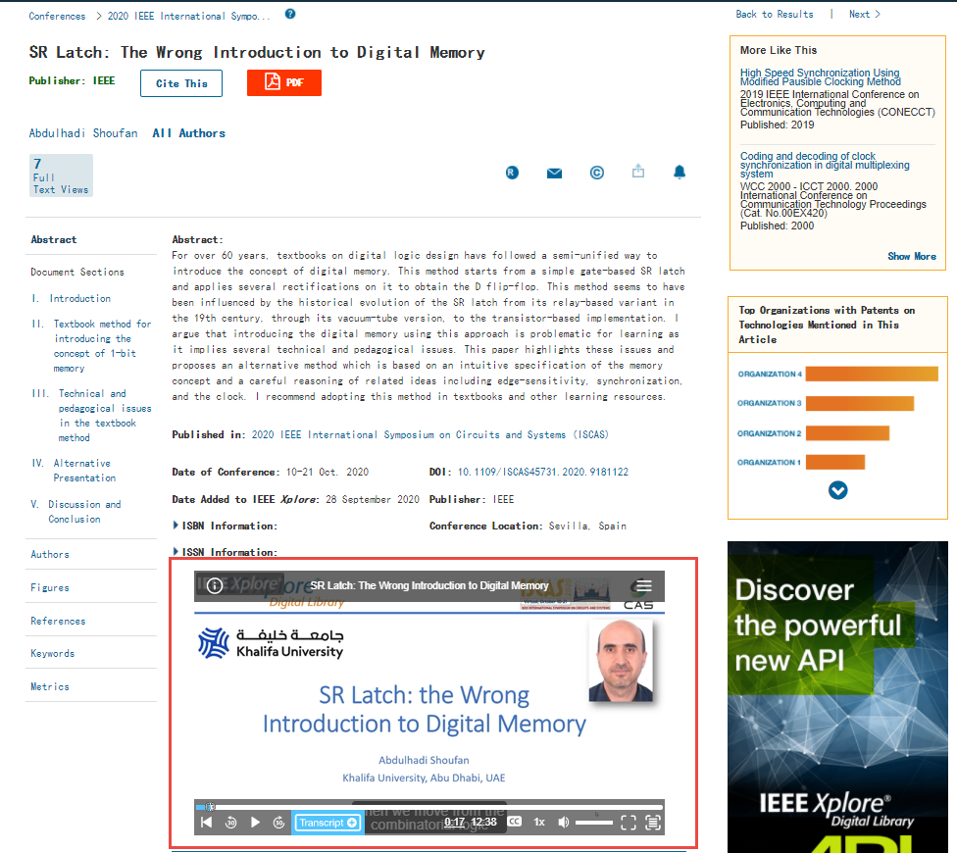
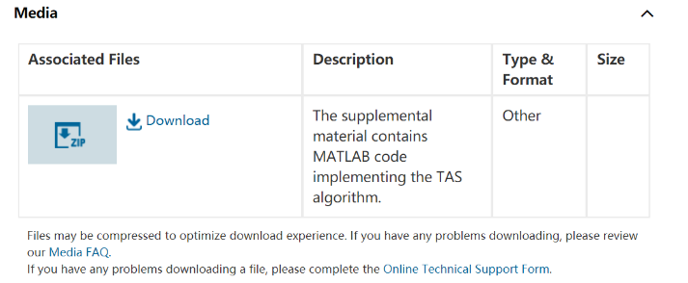
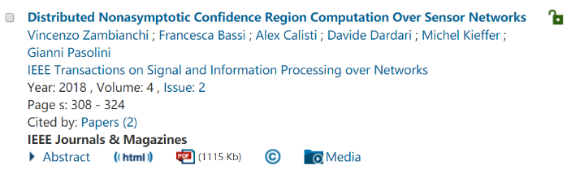
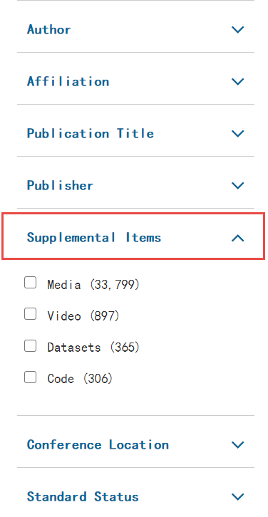
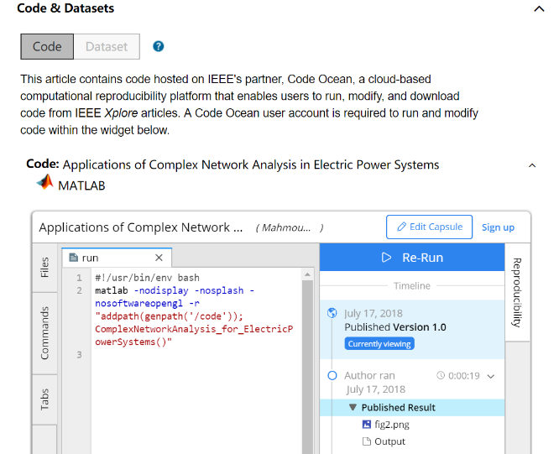
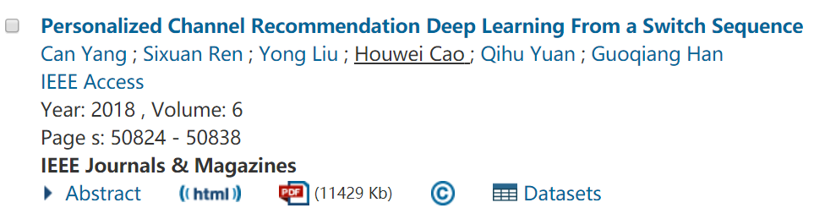
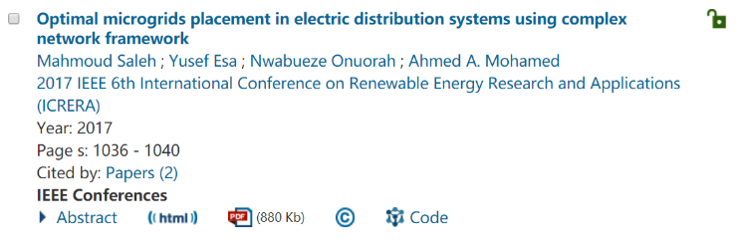
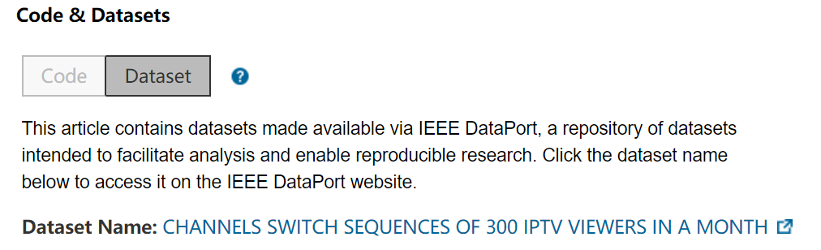

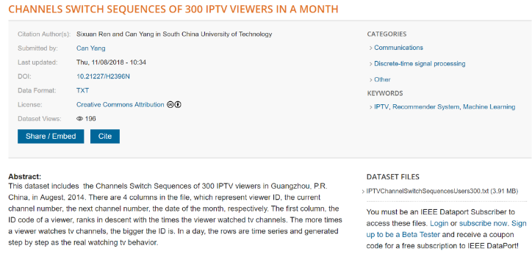
辅助资料：多媒体、视频、代码和数据

Slide 17
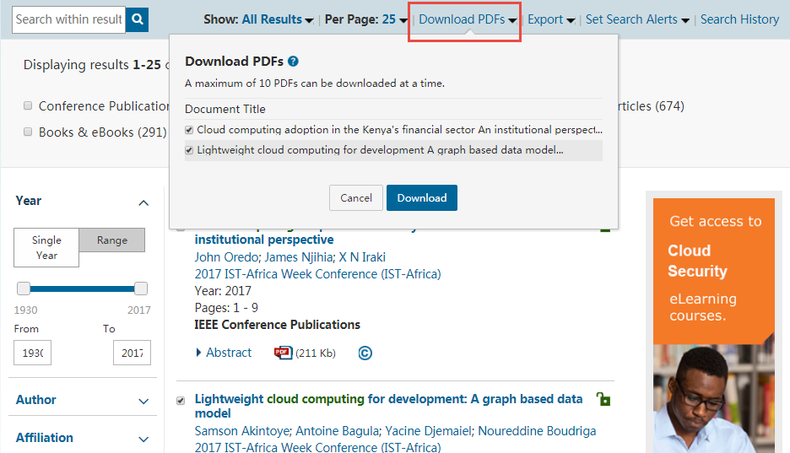
批量下载PDF全文

Slide 18
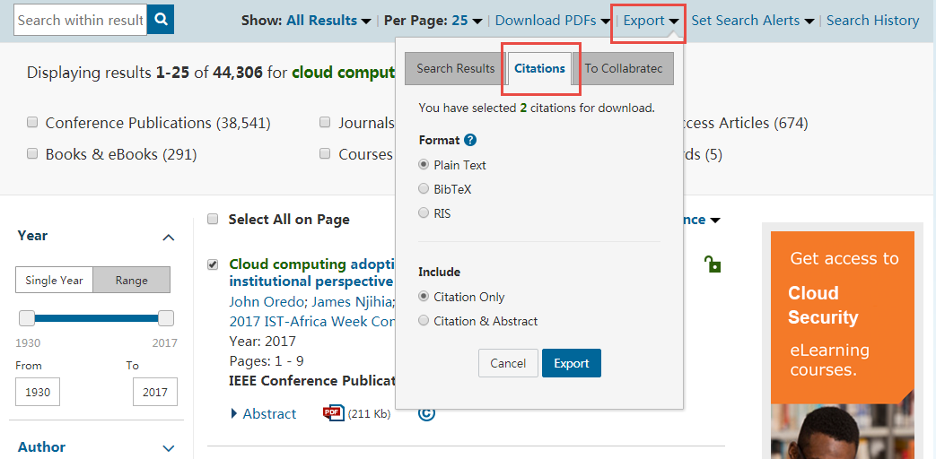
下载引文信息

Slide 19
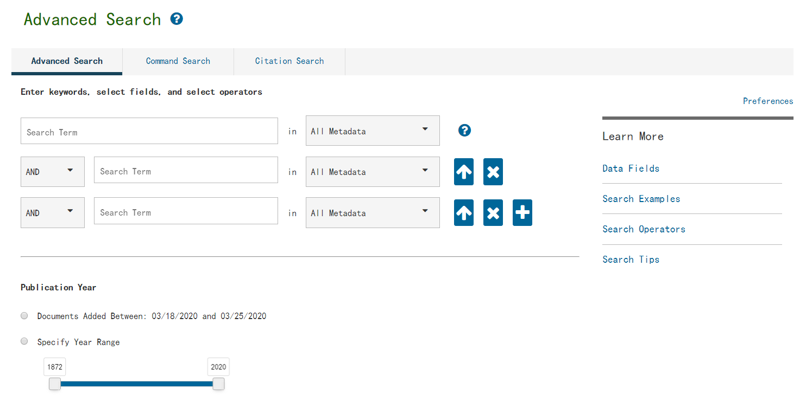
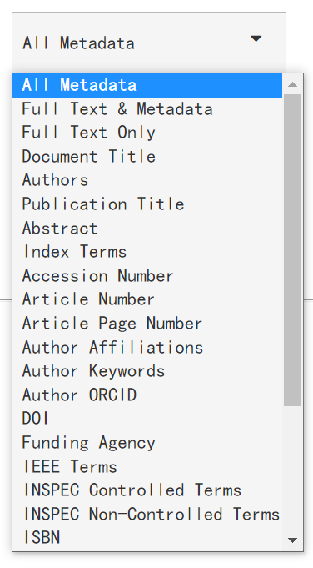
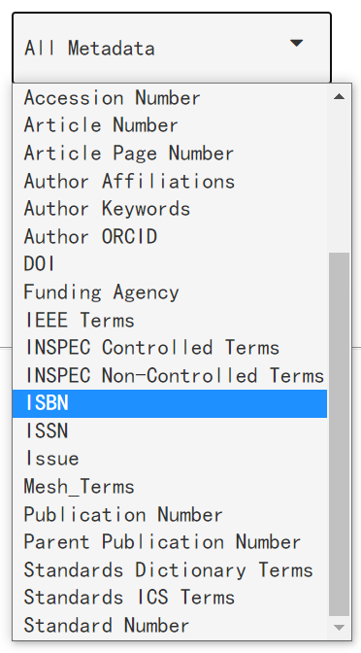
高级检索建构精准表达式

Slide 20
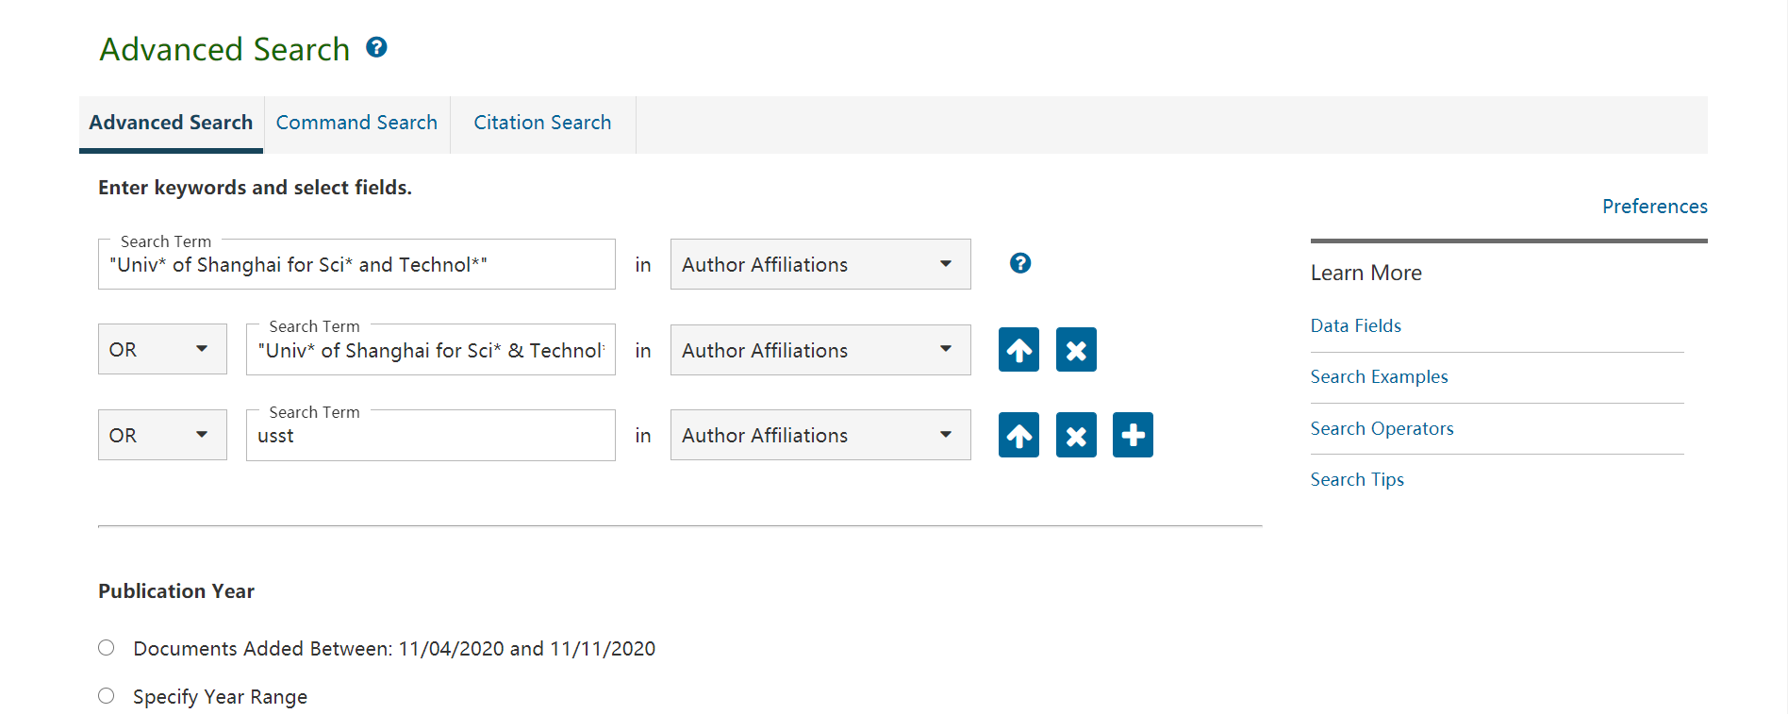
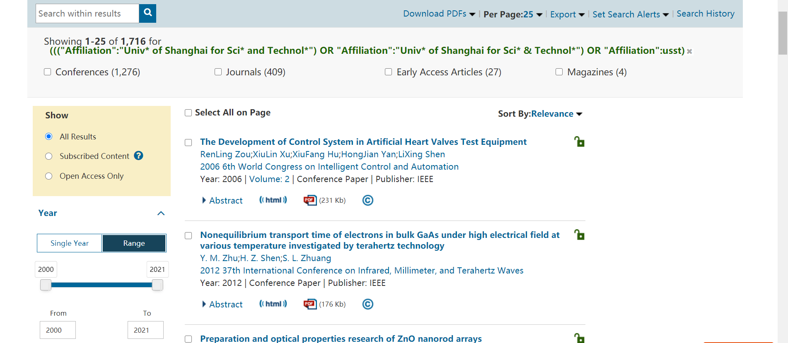
高级检索了解我校发文情况

Slide 21
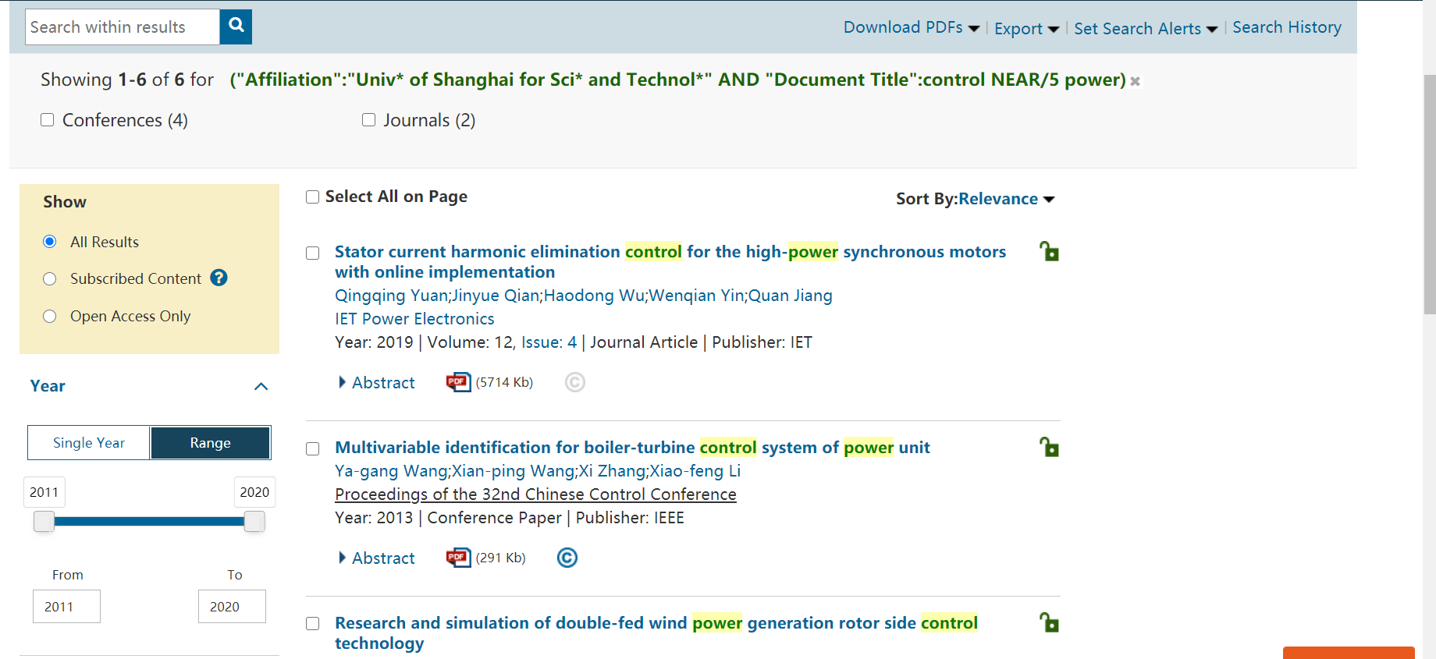
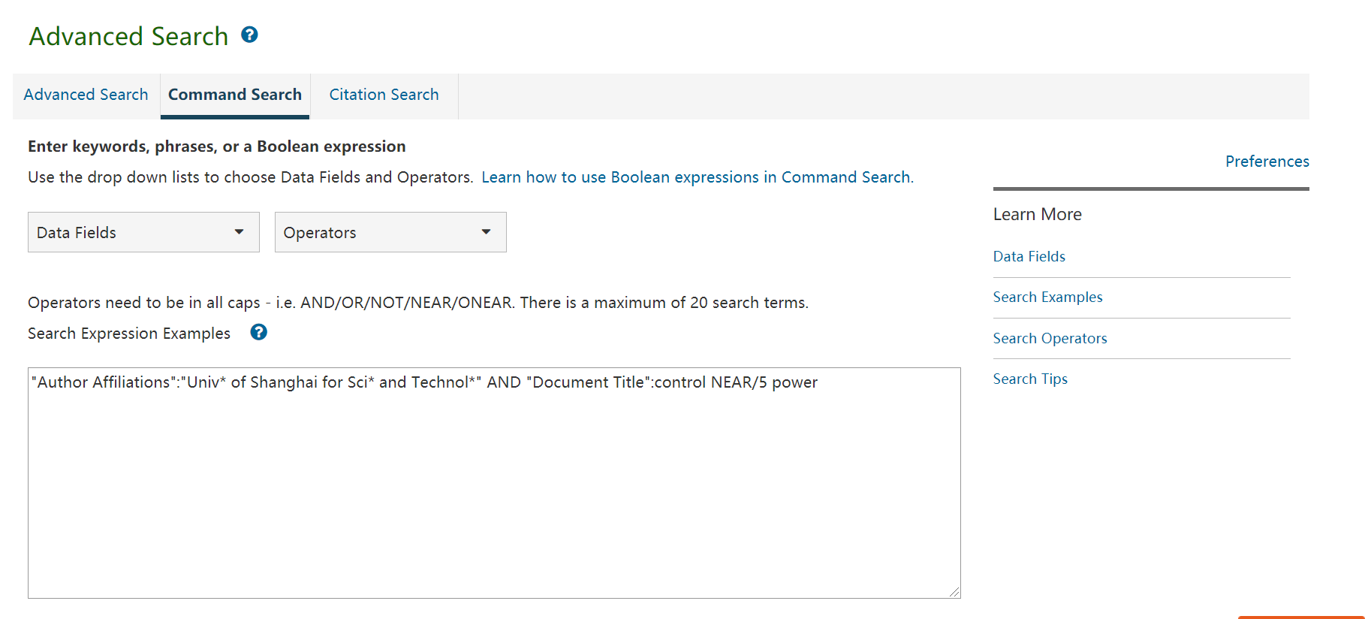
高级检索精确了解我校相关领域发文情况

Slide 22
IEEE Xplore三种检索方式
 | Global Search | Advanced Search | Command Search
是否支持检索字段 | 支持所有检索字段，需手动输入 | 支持所有检索字段 下拉菜单选择
是否支持检索符 | AND/OR/NOT/NEAR/ONEAR | AND/OR/NOT | AND/OR/NOT/NEAR/ONEAR
是否支持括号嵌套 | 支持( )限定优先顺序 | 不支持 | 支持( )限定优先顺序
精确检索（词组） | 双引号“”
模糊检索（截词符） | * （多个字母）或 ？（单个字母）
单个检索从式单词数量限制（以检索符为界） | 15
整个检索式单词数量限制 | 40
单个检索式截词符数量限制 | 7

Slide 23
注册账号—个人设置
追踪与掌握最新技术动态
检索提醒
※ 定制热点技术信息推送
※ 掌握机构研究动态
※ 掌握权威研究人员最新进展
内容提醒
※ 订阅期刊、会议、标准、电子书更新

Slide 24
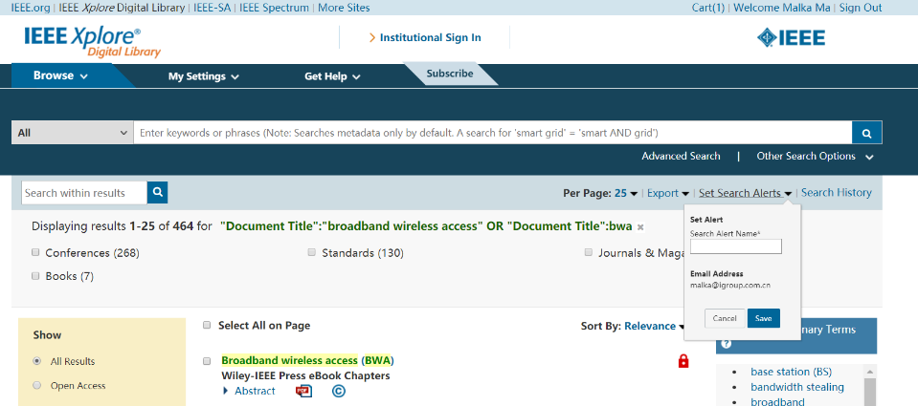
检索提醒：针对检索式进行订阅提醒

Slide 25
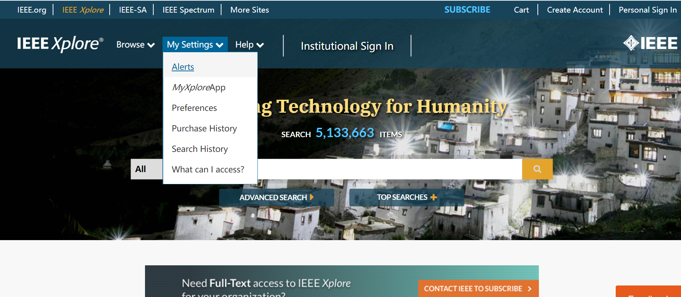
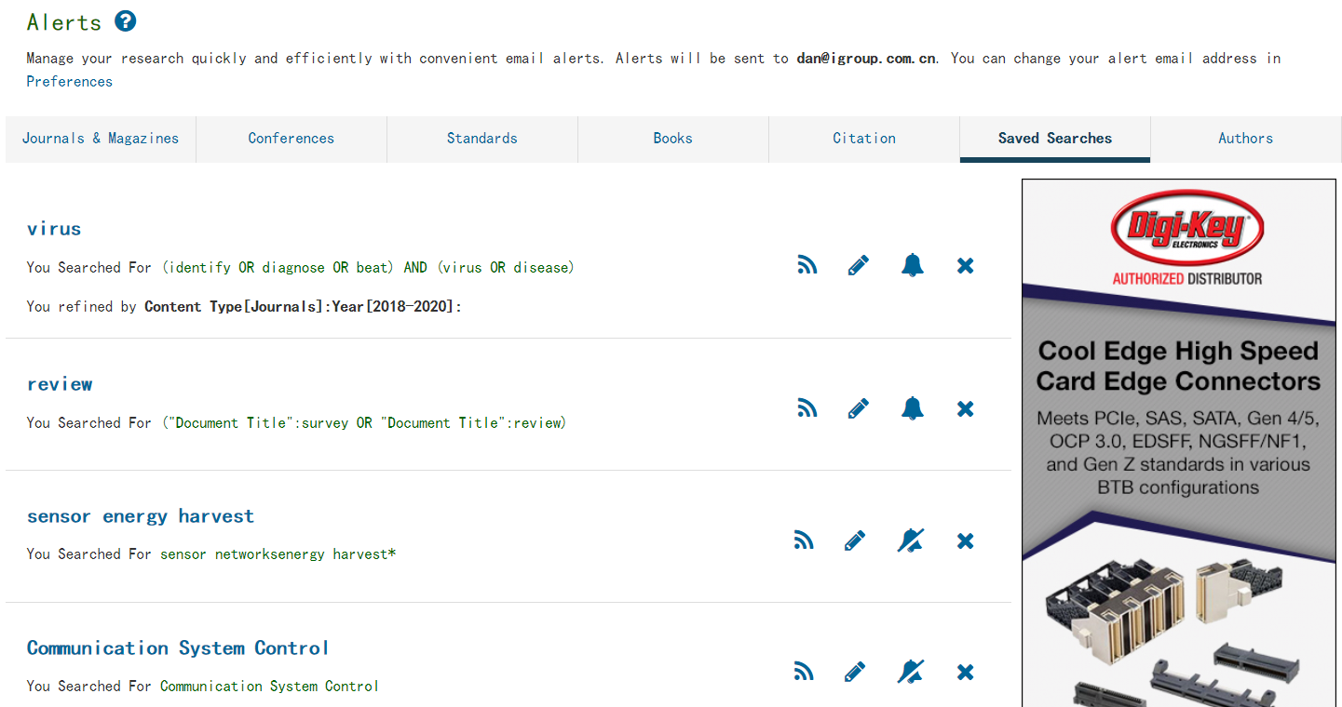
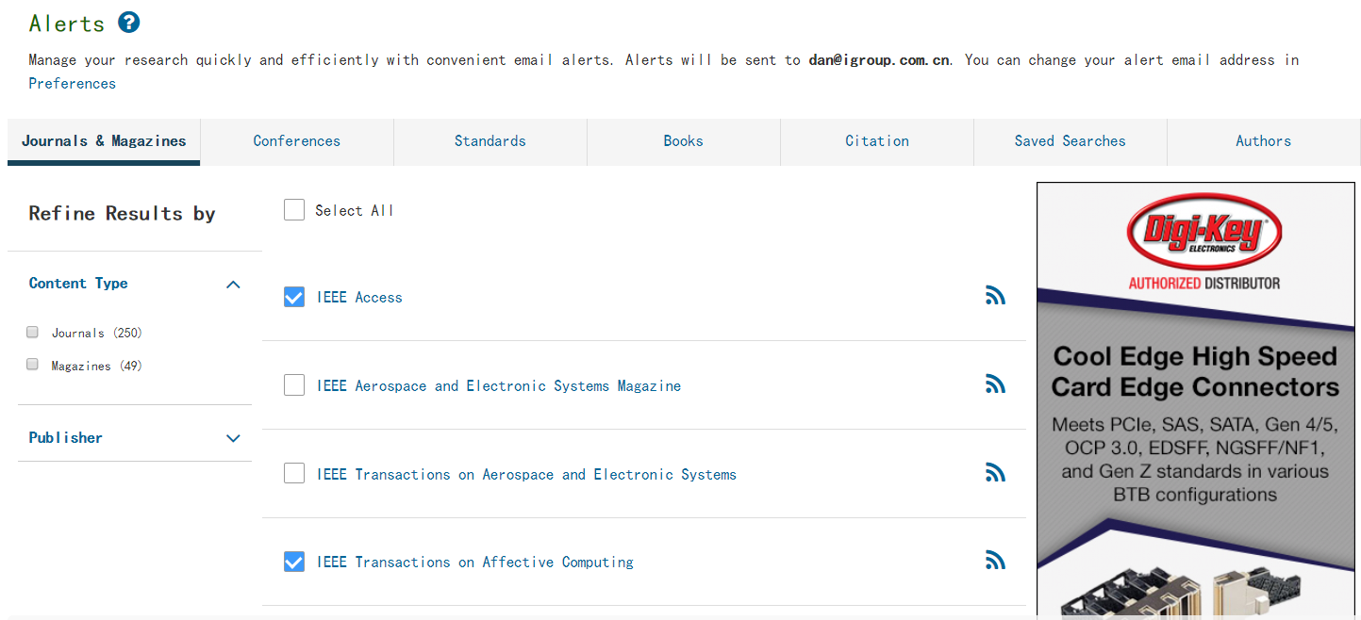
查看、管理已经订阅的检索提醒
订阅期刊、会议、标准、电子书更新

Slide 26

MyXplore App—随时随地掌握前沿资讯
iTunes App Store
Google Play
Android
腾讯应用宝
360手机助手
百度手机助手
小米应用商店
oppo/vivo应用商店
……

Slide 27
IEEE国际期刊/会议
投稿流程与注意事项

Slide 28


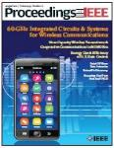

IEEE 期刊
190+
Journals, Transactions, Magazines
约80%被SCI收录
基本均被EI收录

Slide 29
IEEE quality makes an impact
Clarivate Analytics Journal Citation Reports® by Impact Factor
IEEE publishes:
27 of the top 30 journals in Electrical and Electronic Engineering
21 of the top 25 journals in Telecommunications
5 of the top 5 Automation & Control Systems
4 of the top 5 journals in Computer Science, Information Systems
4 of the top 5 journals in Computer Science, Hardware & Architecture
4 of the top 5 journals in Computer Science, Software Engineering
3 of the top 5 journals in Computer Science, Artificial Intelligence
Clarivate Analytics Journal Citation Reports presents quantifiable statistical data that provides a systematic, objective way to evaluate the world’s leading journals.
Based on the 2019 study released June 2020
More info: www.ieee.org/publications/subscriptions/journal-citations.html

Slide 30
电气电子领域 高被引期刊
2. IEEE Transactions on Pattern Analysis and Machine Intelligence
3. IEEE Industrial Electronics Magazine
4. IEEE Journal on Selected Areas in Communications
5. IEEE Wireless Communications Magazine
6. IEEE Signal Processing Magazine
7. IEEE Communications Magazine
8. Proceedings of the IEEE
9. IEEE Internet of Things Journal
10. IEEE Transactions on Fuzzy Systems
11. IEEE Transactions on Image Processing
12. IEEE Network
13. IEEE Transactions on Neural Networks and Learning Systems
14. IEEE Transactions on Smart Grid
15. IEEE Vehicular Technology Magazine
16. IEEE Transactions on Industrial Electronics
17. IEEE Transactions on Sustainable Energy
20. IEEE Transactions on Wireless Communications
21. IEEE Transactions on Medical Imaging
22. IEEE Transactions on Power Electronics
23. IEEE Transactions on Intelligent Transportation Systems
24. IEEE Transactions on Software Engineering
25. IEEE Transactions on Power Systems
26. IEEE Transactions on Information Forensics and Security
27. IEEE Transactions on Geoscience and Remote Sensing
28. IEEE/ASME Transactions on Mechatronics
29. IEEE Transactions on Communications
30. IEEE Transactions on Automatic Control

Slide 31
通信领域 高被引期刊
1. IEEE Communications Surveys and Tutorials
2. IEEE Journal on Selected Areas in Communications
3. IEEE Wireless Communications Magazine
4. IEEE Communications Magazine
5. IEEE Internet of Things Journal
6. IEEE Network
7. IEEE Vehicular Technology Magazine
8. IEEE Transactions on Wireless Communications
9. IEEE Transactions on Multimedia
10. IEEE Transactions on Emerging Topics in Computing
11. IEEE Transactions on Communications
13. IEEE Transactions on Vehicular Technology
14. IEEE Transactions on Mobile Computing
17. IEEE Wireless Communications Letters
19. IEEE Transactions on Cognitive Communications and Networking
20. IEEE Pervasive Computing Magazine
21. IEEE Transactions on Antennas And Propagation
22 Journal of Lightwave Technology
23. IEEE Consumer Electronics Magazine
24. IEEE Systems Journal
25. IEEE Antennas and Propagation Magazine

Slide 32
计算机领域 高被引期刊
Computer Science—Hardware & Architecture
#1 IEEE Wireless Communications Magazine
#2 IEEE Network
#3 IEEE Transactions on Neural Networks and Learning Systems
#5 IEEE Transactions on Dependable and Secure Computing
Computer Science—Software Engineering
#3 IEEE Transactions on Dependable and Secure Computing
#4 IEEE Transactions on Software Engineering
#5 IEEE Transactions on Multimedia
ComputerScience—Information Systems
#1 IEEE Communications Surveys and Tutorials
#2 IEEE Wireless Communications Magazine
#3 IEEE Internet of Things Journal
#4 IEEE Network
Computer Science—Artificial Intelligence
#1 IEEE Transactions on Pattern Analysis and Machine Intelligence
#3 IEEE Transactions on Evolutionary Computation
#5 IEEE Transactions on Cybernetics

Slide 33
自动化控制领域 高被引期刊
Automation and Control Systems
#1 IEEE Transactions on Cybernetics
#2 IEEE Transactions on Systems, Man, and Cybernetics: Systems
#3 IEEE Transactions on Industrial Informatics
#4 IEEE Transactions on Industrial Electronics
#5 IEEE Control Systems Magazine
交通领域 高被引期刊
Imaging Science & Photographic Technology
#1 IEEE Geoscience and Remote Sensing Magazine
#4 IEEE Transactions on Medical Imaging
#5 IEEE Transactions on Geoscience and Remote Sensing
图像领域 高被引期刊
Imaging Science & Photographic Technology
#1 IEEE Geoscience and Remote Sensing Magazine
#3 IEEE Transactions on Medical Imaging
#5 IEEE Transactions on Geoscience and Remote Sensing

Slide 34
2020 IEEE 新刊
New Periodicals for 2020
IEEE Journal of Emerging and Selected Topics in Industrial Electronics
IEEE Journal on Selected Areas in Information Theory
IEEE Journal of the Electron Devices Society
IEEE Open Journal of Antennas and Propagation
IEEE Open Journal of Circuits and Systems
IEEE Open Journal of the Communications Society
IEEE Open Journal of the Computer Society
IEEE Open Journal of Engineering in Medicine and Biology
IEEE Open Journal of the Industrial Electronics Society
IEEE Open Journal of Industry Applications
IEEE Open Journal of Intelligent Transportation Systems
IEEE Open Journal of Nanotechnology
IEEE Open Access Journal of Power and Energy
IEEE Open Journal of Power Electronics
IEEE Open Journal of Signal Processing
IEEE Open Journal of Solid-State Circuits
IEEE Open Journal of Vehicular Technology
IEEE Magnetics Letters
IEEE Transactions on Artificial Intelligence
IEEE Transactions on Technology and Society

Slide 35
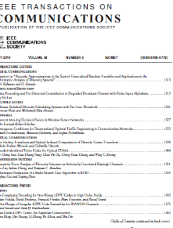
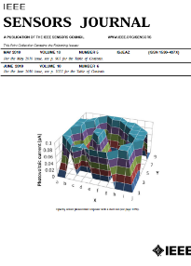
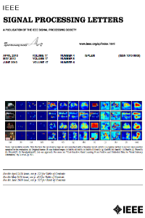
学术期刊
Journals, Transactions, and Letters are the primary means for publishing technical papers concerning original work in IEEE fields of interest.
  The primary purpose of Journals, Transactions, and Letters is to disclose and provide a permanent archival record of original technical work that advances the state of the art or provides novel insights.
  Letters are for the publication of brief papers, usually three to four pages in length.

Slide 36
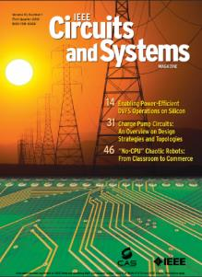


技术杂志
Magazines are characterized by regular and continuing issues with significant technical content in addition to general news and regular columns
  IEEE Communications Magazine
  IEEE Microwave Magazine
  IEEE Signal Processing Magazine
  IEEE Instrumentation & Measurement Magazine
  ......

Slide 37
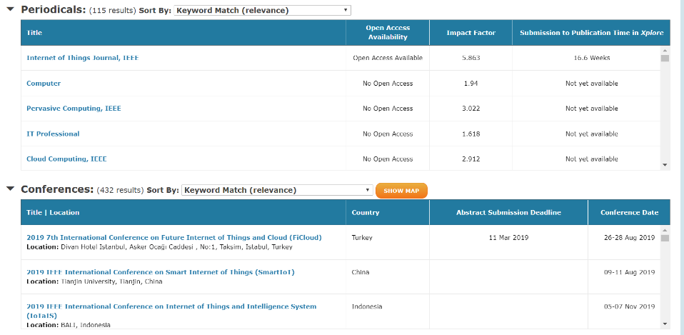
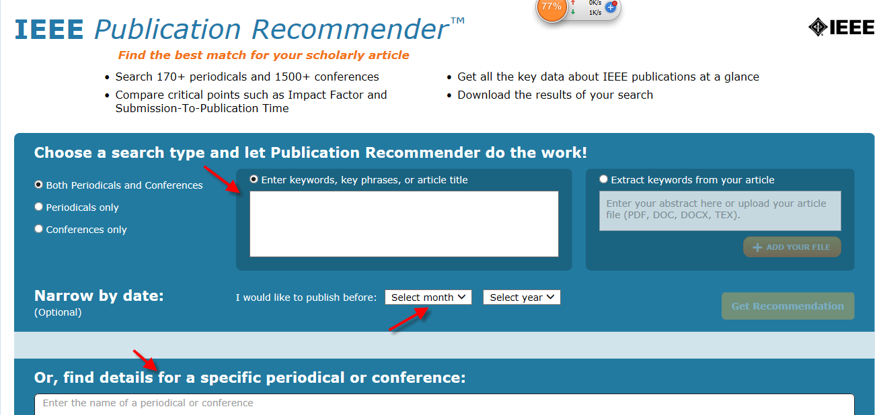
IEEE Publication Recommender™
http://publication-recommender.ieee.org/home

Slide 38
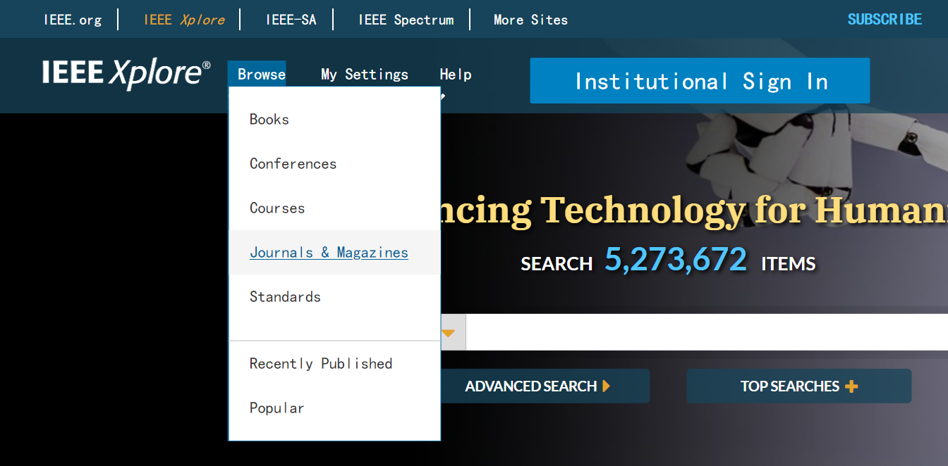
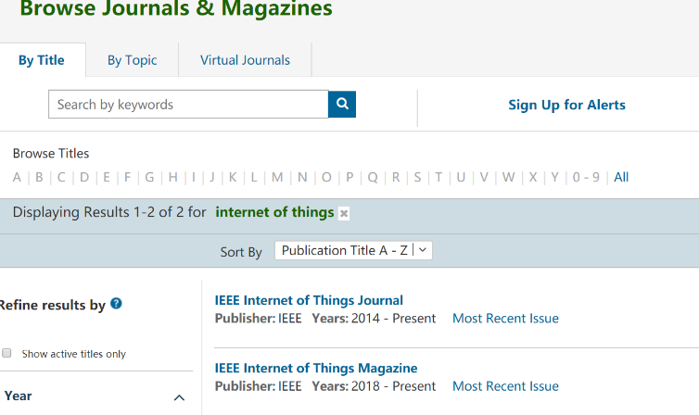
在 IEEE Xplore 寻找合适的期刊

Slide 39
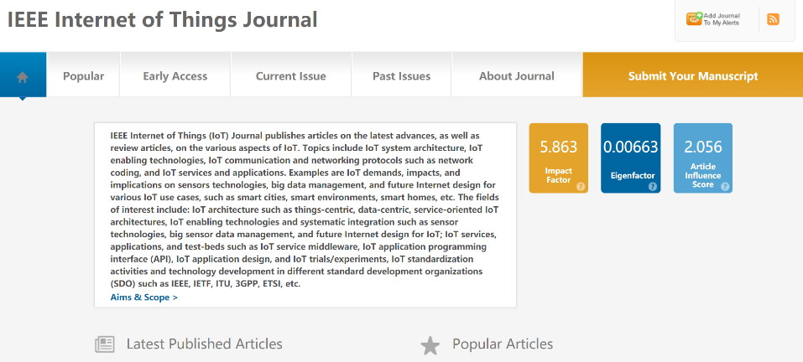

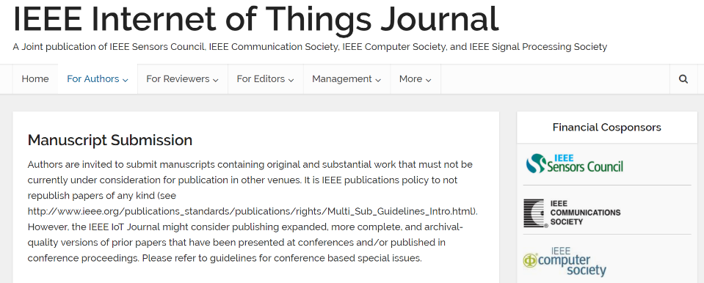
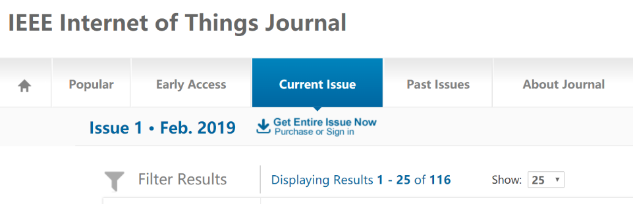
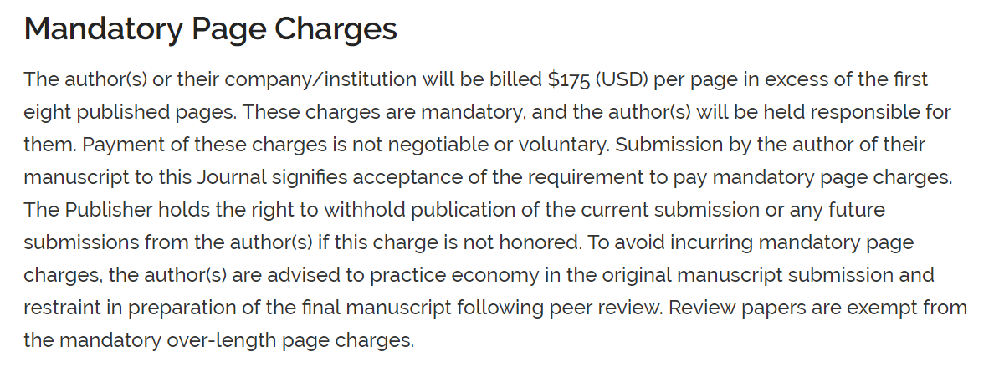
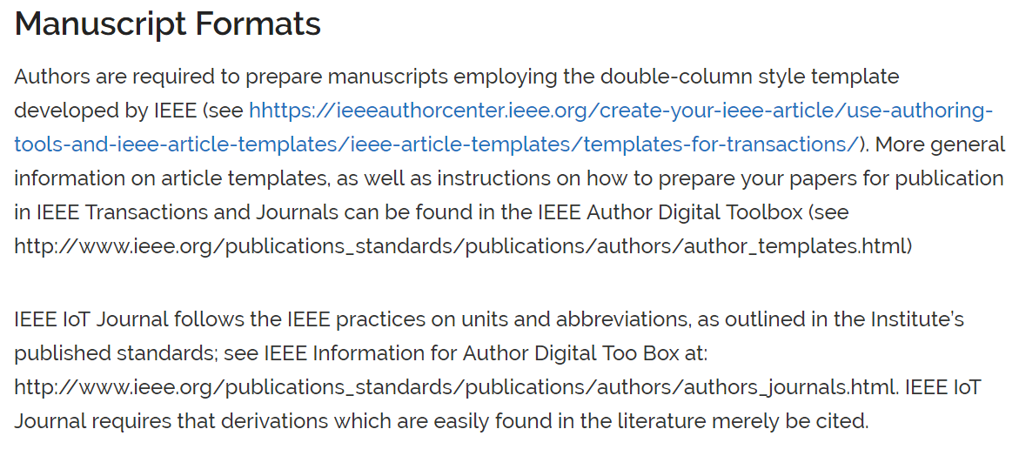


期刊信息与投稿

Slide 40




提交文章

Slide 41
评审流程 Review Process
Submission
Rejection: topic
Journal Staff
Rejection: format
EIC
Accept
AE
Reviewers
Revise
EIC Makes Decision
Reject

Slide 42




论文检测（查重）
包括 IEEE 在内的国际主要出版机构和大部分 SCI 期刊都使用iThenticate/CrossCheck审查稿件。
  大部分SCI、SCI-E期刊使用该系统审查稿件
    86%的期刊编辑依靠iThenticate检测结果做出评判*
  高重复率可能被：
    ！拒稿
    ！认定抄袭
    ！更严重后果…
Notes:
前面在IEEE的投稿页面上，有一段说明：IEEE会对所有稿件使用CrossCheck系统进行抄袭审查。CrossCheck，或者大家可能听说过它的另一个名字iThenticate。其实国际主要出版机构和大部分SCI期刊都在使用iThenticate/CrossCheck审查稿件，以保证稿件的质量。并且有86%的期刊编辑会依靠iThenticate的重复率检测结果对稿件做出评判。高重复率稿件很可能被拒稿。

Slide 43


作者中心与作者工具
https://ieeeauthorcenter.ieee.org/
Notes:
使用的模板
学术不端的限定
多媒体文档如何上传
参考文献自动检测

Slide 44
IEEE会议
1,900+
Conferences
190+
Journals, Transactions, Magazines
基本均被EI收录

Slide 45
会议论文和期刊论文的区别
会议主要目的是通过演讲现场交流信息和交换想法
会议常常反映最新最前沿的研究，很多研究尚未到达正式期刊发表的程度。所以会议主要是快速传播科研信息，以从观众中获取宝贵的意见和反馈
会议常常会尽可能能覆盖较多的参与者，所以很多会议论文接受率较高
没有演讲此类口头交流信息的形式
期刊发表体现更严格的评审以及更高质量的成果
大部分期刊论文至少有3名以上评审人审稿，并有副主编定稿
期刊论文必须很好地反映该领域研究状态，因为评审人会仔细审核其引用文献
期刊论文接受率通常远低于会议论文

Slide 46


浏览与参加IEEE会议
Notes:
改infocom
了解往届文章的程度、方向、格式、周期等

Slide 47



查找即将召开的IEEE会议——IEEE Xpore主页底部
https://www.ieee.org/conferences/index.html
Notes:
每年都有新会，建议在这个平台了解更多会议情况

Slide 48






举例

Slide 49
IEEE活动介绍，
助力科研与职业发展

Slide 50
欢迎参与IEEE学术交流！
Involvement in IEEE Societies, Sections and Chapters
Over 3,000 Student Branches in over 100 countries
Participation in IEEE Young Professional and Women in Engineering
1800+ conferences per year
IEEE Social media, such as Weibo, WeChat, etc.
Notes:
大量的社交平台，结识学术人脉，拓展学术交流圈，

Slide 51

IEEE免费技术讲座
Spectrum免费讲座，涉及最新科技：http://spectrum.ieee.org/webinars
Communication Society免费讲座，通信领域热点技术：http://www.comsoc.org/webinars
Computer Society免费讲座，计算机领域热点技术：
http://www.computer.org/portal/web/webinars/Register-for-a-Webinar
Young Professional社团免费讲座，涉及职业发展，人文，科技等内容：
http://yp.ieee.org/members/webinars/past-webinars/
加入志愿者虚拟社团，获得行业最新咨询：
http://oc.ieee.org/

Slide 52
欢迎申请丰厚的IEEE奖学金！
IEEE Fellowship/Scholarship
  IEEE Charles LeGeyt Fortescue Fellowship
  IEEE Computational Intelligence Society Conference Travel Grants
  IEEE Computational Intelligence Society Summer Research Grant
  IEEE Computer Society Merwin Scholarship
  IEEE Dielectrics and Electrical Insulation Society Graduate Student Fellowship
  IEEE Electron Devices Society Graduate Student Fellowship
  IEEE James C. Klouda Memorial Scholarship Award
  ……
IEEE Competitions
  Presidents' Change the World Competition
  IEEE Computer Society Simulator Design Competition
  Student paper contest
  ……
https://www.ieee.org/membership/students/scholarships-grants-and-fellowships.html

Slide 53


IEEE 极限编程大赛
全球规模的竞赛，以队为单位参加，24小时内完成，题目为一系列程序设计的问题。获奖团队将获得一次全球任何地方的IEEE国际会议旅行资助。
报名日期：
每年9月
比赛日期：
每年10月第三个星期六
报名网站：
http://www.ieee.org/xtreme

Slide 54



Slide 55

欢迎关注！
微信公众号 ： IEEE QQ交流群：
“IEEE Xplore微服务” 184712678
下载 PPT 请关注微信公众号，首页回复 上海理工大学 获取下载链接。
iGroup中国 IEEE数据库团队
iel@igroup.com.cn
Notes:
修改学校名称

